Slide 1
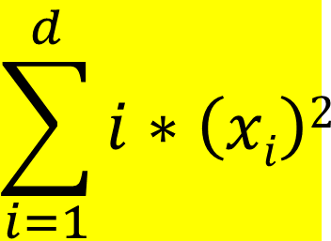
Problem-01
Sum squares function
$$\sum_{i=1}^{d}{i∗\left(xi\right)2}$$
The Initial values for the variables are :
[-4.25126165 2.25045999 3.86836256 -2.85891749 -1.20439751]
The no. of iteration are :
11
The Finals values for the variables are :
[0.03392 0. 0. 0. 0.00705]
The Final Value of Objective Function is:
0.0014
iteration | fuction value
0 | 113.0415562
1 | 13.95963306
2 | 4.988840647
3 | 2.115518144
4 | 0.928585512
5 | 0.411150973
6 | 0.182454488
7 | 0.081011081
8 | 0.035974507
9 | 0.015975702
10 | 0.007094615
11 | 0.003150638

Slide 2
The Initial values for the variables are :
[ 3.08081444 -4.48183759 4.12724124 5.00279459 0.06913181]
The no. of iteration are :
9
The Finals values for the variables are :
[0.03184 0. 0. 0.00092 0.00712]
The Final Value of Objective Function is:
0.00127
iteration | fuction value
0 | 200.9032258
1 | 15.29643481
2 | 2.905216227
3 | 0.902044631
4 | 0.313460863
5 | 0.112721019
6 | 0.041864188
7 | 0.016181778
8 | 0.006734849
9 | 0.002893556

Slide 3
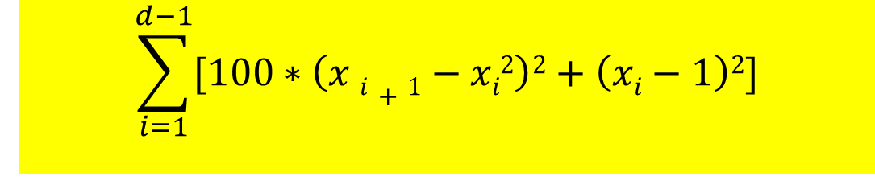
Problem-02
Rosenbrock function
$$\sum_{i=1}^{d−1}{[100∗\left(x i+1−xi2\right)2+\left(xi−1\right)2]}$$
The Initial values for the variables are :
[-1.95596993 1.39318078 -0.80398019]
The no. of iteration are :
6554
The Finals values for the variables are :
[0.9998 0.9996 0.99919]
The Final Value of Objective Function is:
0.0
**************************************************

Slide 4
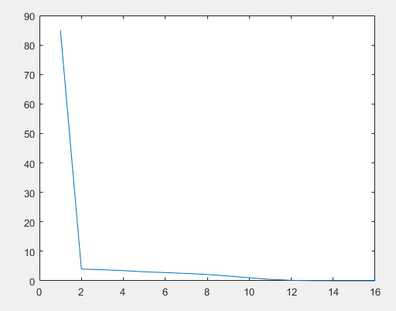
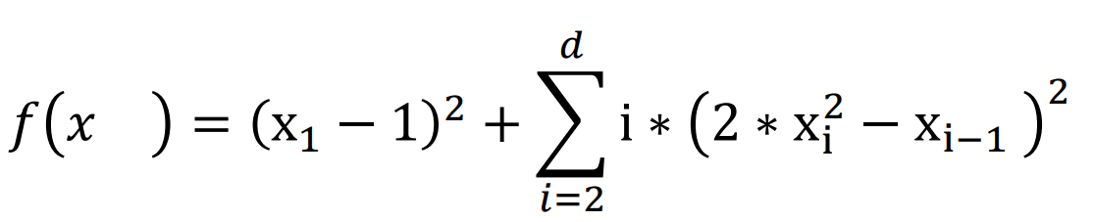
Problem-03
Dixon Price function
The Initial values for the variables are :
**************************************************************
[ 8.04073328 -2.25229416 3.32688472 1.89912193]
The no. of iteration are :
**************************************************************
70
The Finals values for the variables are :
**************************************************************
[0.99998 0.7071 0.5946 0.54525]
The Final Value of Objective Function is:
0.0
**************************************************************

Slide 5
0 | 2002.409034
1 | 246.5211285
2 | 143.6295152
3 | 41.833116
4 | 13.78611687
5 | 3.850053609
6 | 2.667652331
7 | 1.04724322
8 | 1.032079862
9 | 1.029707016
10 | 1.025313527
11 | 1.016053127
12 | 0.995074016
13 | 0.947130612
14 | 0.762271938
15 | 0.463299116
16 | 0.247178136
17 | 0.144539476
18 | 0.089207745
19 | 0.059167889
20 | 0.039426415
21 | 0.026763332
22 | 0.018450269
23 | 0.012819008
24 | 0.008895265
25 | 0.006191987
26 | 0.004351466
27 | 0.003068794
28 | 0.002147031
29 | 0.001507084
30 | 0.00106544
31 | 0.000752763
32 | 0.000530766
33 | 0.000372798
34 | 0.000264961
35 | 0.000187702
36 | 0.000132551
37 | 9.37E-05
38 | 6.64E-05
39 | 4.72E-05
40 | 3.33E-05
41 | 2.36E-05
42 | 1.67E-05
43 | 1.19E-05
44 | 8.38E-06
45 | 5.92E-06
46 | 4.20E-06
47 | 2.98E-06
48 | 2.11E-06
49 | 1.49E-06
50 | 1.06E-06
51 | 7.56E-07
52 | 5.43E-07
53 | 3.89E-07
54 | 2.78E-07
55 | 1.99E-07
56 | 1.42E-07
57 | 1.02E-07
58 | 7.29E-08
59 | 5.24E-08
60 | 3.78E-08
61 | 2.73E-08
62 | 1.96E-08
63 | 1.41E-08
64 | 1.02E-08
65 | 7.37E-09
66 | 5.34E-09
67 | 3.88E-09
68 | 2.82E-09
69 | 2.05E-09
70 | 1.49E-09

Slide 7
0 | 10665.59767
1 | 46.27368977
2 | 17.01800177
3 | 1.070257179
4 | 1.034884804
5 | 1.03158794
6 | 1.031299235
7 | 1.03127012
8 | 1.031268111
9 | 1.031266811
10 | 1.031265922
11 | 1.031265274
12 | 1.031264755
13 | 1.031264257
14 | 1.031263786
15 | 1.031263339
16 | 1.031262915
17 | 1.031262507
18 | 1.031262119
19 | 1.031261749
20 | 1.031261396
21 | 1.031261058
22 | 1.031260735
23 | 1.031260425
24 | 1.031260129
25 | 1.031259844
26 | 1.031259571
27 | 1.031259311
28 | 1.031259061
29 | 1.031258818
30 | 1.031258587
31 | 1.031258364
32 | 1.03125815
33 | 1.031257944
34 | 1.031257746
35 | 1.031257554
36 | 1.031257369
37 | 1.031257192
38 | 1.03125702
39 | 1.031256855
40 | 1.031256695
41 | 1.031256541
42 | 1.031256392
43 | 1.031256248
44 | 1.031256108
45 | 1.031255974
46 | 1.031255844
47 | 1.031255717
48 | 1.031255595
49 | 1.031255477
50 | 1.031255363
51 | 1.031255251
52 | 1.031255143
53 | 1.031255039
54 | 1.031254939
55 | 1.03125484
56 | 1.031254743
57 | 1.031254652
58 | 1.031254562
59 | 1.031254474
60 | 1.031254388
61 | 1.031254307
62 | 1.031254227
63 | 1.031254148
64 | 1.031254072
65 | 1.031253998
66 | 1.031253927
67 | 1.031253857
68 | 1.031253788
69 | 1.031253722
70 | 1.031253658
71 | 1.031253594
72 | 1.031253532
73 | 1.031253473
74 | 1.031253415
75 | 1.031253358
76 | 1.031253302
77 | 1.031253248
78 | 1.031253196
79 | 1.031253144
80 | 1.031253093

Slide 8
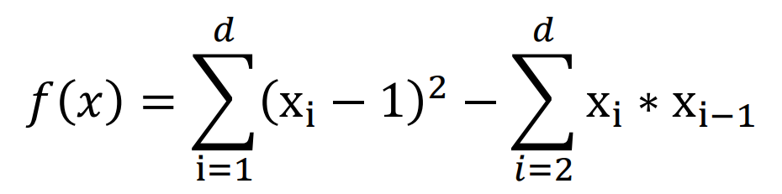
Problem-04
Trid function
The Initial values for the variables are :
[ -0.16402285 15.4655353 -12.7774776 27.19680957 34.62702787
6.13501611]
The no. of iteration are :
**************************************************************
70
The Finals values for the variables are :
**************************************************************
[ 6.00104 10.0017 12.00234 12.00212 10.00188 6.00094]
The Final Value of Objective Function is:
-50.0
**************************************************************

Slide 9
iteration | fuction value
0 | 1637.315575
1 | 106.8201019
2 | 7.80161689
3 | -23.6493788
4 | -37.37602991
5 | -43.62227469
6 | -46.53677845
7 | -47.94228756
8 | -48.65859309
9 | -49.05158836
10 | -49.28950209
11 | -49.44742726
12 | -49.56138604
13 | -49.64789756
14 | -49.71581699
15 | -49.76998863
16 | -49.81359612
17 | -49.84883512
18 | -49.87737946
19 | -49.90052018
20 | -49.9192857
21 | -49.93450773
22 | -49.94685807
23 | -49.95688016
24 | -49.96501331
25 | -49.97161159
26 | -49.97696587
27 | -49.98131012
28 | -49.98483503
29 | -49.98769526
30 | -49.99001584
31 | -49.991899
32 | -49.99342673
33 | -49.99466622
34 | -49.995672
35 | -49.99648818
36 | -49.99715034
37 | -49.99768763
38 | -49.99812357
39 | -49.99847731
40 | -49.99876433
41 | -49.99899725
42 | -49.99918628
43 | -49.99933969
44 | -49.99946419
45 | -49.99956522
46 | -49.99964721
47 | -49.99971373
48 | -49.99976771
49 | -49.99981151
50 | -49.99984704
51 | -49.99987589
52 | -49.99989929
53 | -49.99991828
54 | -49.99993369
55 | -49.99994619
56 | -49.99995634
57 | -49.99996457
58 | -49.99997125
59 | -49.99997667
60 | -49.99998107
61 | -49.99998464
62 | -49.99998753
63 | -49.99998988
64 | -49.99999179
65 | -49.99999334
66 | -49.99999459
67 | -49.99999561
68 | -49.99999644
69 | -49.99999711
70 | -49.99999766

Slide 11
iteration | fuction value
0 | 1670.650118
1 | 732.5436833
2 | 355.6488885
3 | 180.1087944
4 | 93.67410918
5 | 48.37405882
6 | 22.03296586
7 | 5.296652913
8 | -6.489169573
9 | -15.25783733
10 | -22.07778344
11 | -27.47747559
12 | -31.8063066
13 | -35.2904857
14 | -38.1040233
15 | -40.37810267
16 | -42.21628953
17 | -43.70253272
18 | -44.90478828
19 | -45.87729094
20 | -46.66456407
21 | -47.30143421
22 | -47.81653437
23 | -48.23331279
24 | -48.57064253
25 | -48.84358894
26 | -49.06430257
27 | -49.24292426
28 | -49.38746598
29 | -49.50444487
30 | -49.59912992
31 | -49.67574009
32 | -49.73772752
33 | -49.78786236
34 | -49.82840608
35 | -49.86119055
36 | -49.88770112
37 | -49.90915599
38 | -49.9265065
39 | -49.94054702
40 | -49.9519025
41 | -49.96109092
42 | -49.96852281
43 | -49.97453591
44 | -49.97939989
45 | -49.98333499
46 | -49.98651835
47 | -49.98909356
48 | -49.99117699
49 | -49.99286227
50 | -49.99422582
51 | -49.9953287
52 | -49.99622111
53 | -49.99694286
54 | -49.99752692
55 | -49.99799925
56 | -49.99838151
57 | -49.99869084
58 | -49.99894109
59 | -49.99914352
60 | -49.9993072
61 | -49.99943957
62 | -49.9995466
63 | -49.99963316
64 | -49.99970319
65 | -49.99975984
66 | -49.9998057
67 | -49.9998428
68 | -49.99987281
69 | -49.99989708
70 | -49.99991674
71 | -49.99993264
72 | -49.99994549
73 | -49.9999559
74 | -49.99996432
75 | -49.99997113
76 | -49.99997665
77 | -49.99998111
78 | -49.99998472
79 | -49.99998764
80 | -49.99999
81 | -49.99999191
82 | -49.99999346
83 | -49.99999471
84 | -49.99999572
85 | -49.99999654
86 | -49.9999972
87 | -49.99999773
88 | -49.99999817
89 | -49.99999852
90 | -49.9999988

Slide 12
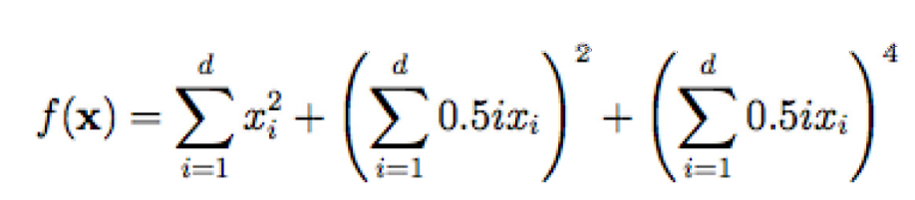
Problem-05
Zakharov function

Slide 13
iteration | fuction value
0 | 16.24702675
1 | 3.799854227
2 | 0.086777739
3 | 0.002062447
4 | 3.86E-05
5 | 6.84E-07
6 | 1.23E-08

Slide 14
The Initial values for the variables are :
[2.89845325 2.46471161]
The no. of iteration are :
**************************************************************
6
The Finals values for the variables are :
**************************************************************
[1.e-05 0.e+00]
The Final Value of Objective Function is:
0.0
**************************************************************

Slide 15
iteration | fuction value
0 | 264.4638264
1 | 2.133574467
2 | 0.037744666
3 | 0.000650491
4 | 1.14E-05
5 | 1.92E-07
6 | 3.62E-09

Slide 16
Conclusions
Rosenbrock required more no. of iteration to achieve minima.
If epsilon value is small then accuracy will better but the number of iteration will be increase and vice versa.
The initial guess as much closer to the minima of the function it will converges very fast and iterations required will be less.
In the starting convergence will be fast but later it will slow.

